Slide 1
Whatever You Say: SQA Analysis
By Ari Butowsky, Dan Citardi, and Brandon Ng
Notes:
Dan

Slide 2

Whatever You Say (WUS)
“If you talk to a man in a language he understands, that goes to his head. If you talk to him in his language, that goes to his heart.”
-Nelson Mandela
The WUS software is a proposed solution to global communication barriers.
Modular Design:
Each module would be created independently of one another due to an inability to deliver all the intended components by the due date.
An external dynamic translation engine that passes original text and gets back translated text. The engine used is Altavista’s Babelfish.
=
Notes:
D

Slide 3
Whatever You Say (WUS) - Purpose(s)
The goals of the WUS software include the following:
Breaking down language barriers in communication
Enabling users to communicate with each other even when countries apart from one another.
Making users aware of each other’s “cultural context” (i.e. Local news, weather, etc.).
Allowing students and academics in different countries to collaborate on research projects despite not being able to understand each other’s native languages.
Allowing for smoother and friendlier communication between coworkers by supplying information concerning a coworker’s time, weather, calendar, local news, etc.
Creating and/or incorporating interactive games where each user sees game boards in their native languages.
Notes:
B

Slide 4
Quality Assurance Process
Review code and documentation
Record findings into a defect log
Various issues that were found in the WUS project are:
User interface problems.
Coding issues.
Design errors.
Ambiguities.
Inconsistencies.
Notes:
B

Slide 5
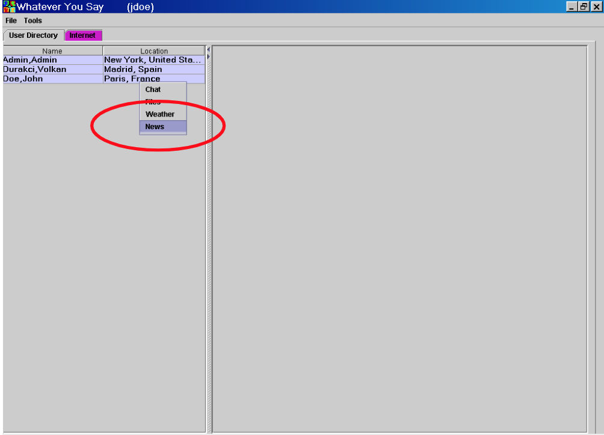
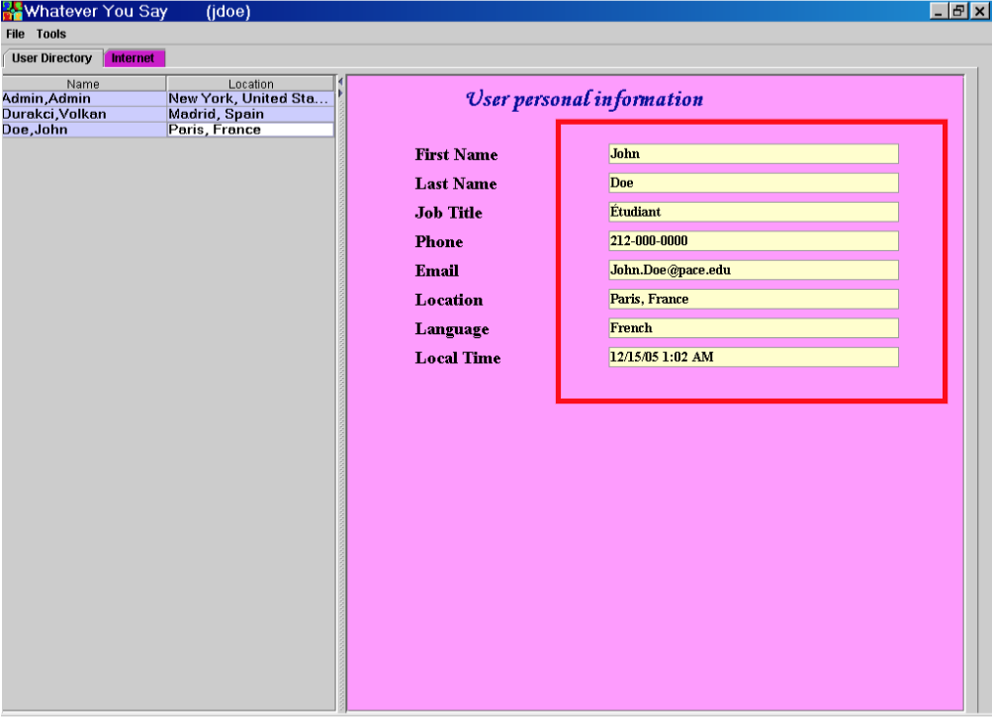
User Interface Problems
Color choice
Missing a way to search for users, as well as a way to sort and/or reverse sort through them.
Can a user hide any information from others (ie. I don’t want people to know my cell phone number)?
In the Administrator Module, why is the Internet tab highlighted in pink?
Notes:
B

Slide 6
Coding Errors
PDFTranslator.java contains a number of packages that don’t even exist.
Many misspelled words in the comments in coding files like PDFViewer.java.
Lots of unused fields, variables, assigned values, import statements, etc.
All of the Java files have missing mandatory Classpath entries.
Many overridable method calls in constructors.
Missing @param tags for parameters.
@Override Annotations missing.
Many fields and field inputs present in the code that can be Final.
StringBuffer can be replaced with StringBuilder.
Using “this” as a parameter in constructor is dangerous when an object isn’t initialized.
Notes:
D

Slide 7
Coding Errors (cont’d)
There are several problems with WUSProperties.properties, including:
Why is it not characters for a virtual keyboard to show all the alphabet for each different language listed?
Why are the number of characters for each language so limited that not all of them are available to the user?
If “itCharacters” refers to the Italian language, the User Manual makes no mention of Italian being one of the languages that files can be translated to?
Why aren’t the characters for the English language listed as well?
Notes:
D

Slide 8
Coding Issues - Inspection Warnings and Errors
As a result of code inspection, many warnings and/or errors were found in the source code, including there being more than one fix for:
Overridable method calls in constructors in WUSSaxXML.java (Lines 64, 57, 50, and 43.), TableSorter.java (Lines 111, 110, 105.), SVGViewer.java (Line 40.), PDFViewer.java (Line 502.), WUSServerConnection.java (Line 95.), and UserProfileForm.java (Lines 98 and 65.).
Comparing Strings using == or != in ChatFrame.java (Line 56.) and WUSServerConnection.java (Line 390.).
The catch(java.lang.Exception) is too broad, it catches the following exception types: java.lang.ClassNotFoundException, java.lang.IllegalAccessException, java.lang.InstantiationException, and java.sql.SQLException at WUSDatabase.java (Line 45.).
The catch(java.lang.Exception) is too broad, it catches the following exception types: java.io.IOException, javax.xml.parsers.ParserConfigurationException and org.xml.sax.SAXException at SVGTranslator.java (Line 51.).
Notes:
D

Slide 9

Design Errors
The scope of the WUS project is missing the feature where the text will be directly translated from language to language by the system.
What determines whether a command is accepted or rejected?
There’s no email server nor is there a calendar function.
Location unclear in design
Red “X’s” in the Prototypes
User profile - are email and phone number verified?
Notes:
D

Slide 10

Ambiguities
“The look and feel…”
“User friendly GUI”
“The system shall be secure…”
All of the students have PCs, so how will this be tested on a Mac?
What is “source control software”?
How can the user just turn off dynamic translation in case of translation problems? Would this even solve such problems?
If .pdf files take a long time to translate, why let them be uploaded in the first place?
How is “online help” available to the user? What does (SRS) even mean by this?
Notes:
D

Slide 11

Ambiguities (cont’d)
Other translation options
What languages can each group member speak?
How will additional features for the WUS software be implemented in the future?
Are you sure there are no legal, financial, or safety issues related to WUS?
How will the User Directory load quickly even when there are many users?
Is there anything that could affect WUS’s loading speed, as well as how fast a user can search and sort through the user list?
Notes:
D

Slide 12

Ambiguities (cont’d)
Are there any limits on the following and what happens when those limits are reached?:
Number of users allowed in the User Directory at one time?
In the Internet/Intranet Module:
What does the No Translation button do? If this shows the original non-translated web page, shouldn’t this be stated in the User’s Manual?
Where is the “Get Web Page” button?
Why is the User Directory tab colored pink? If this is to indicate that the selected tab is in gray, shouldn’t the User’s Manual state this?
What does the “Reset” button do?
Notes:
D

Slide 13
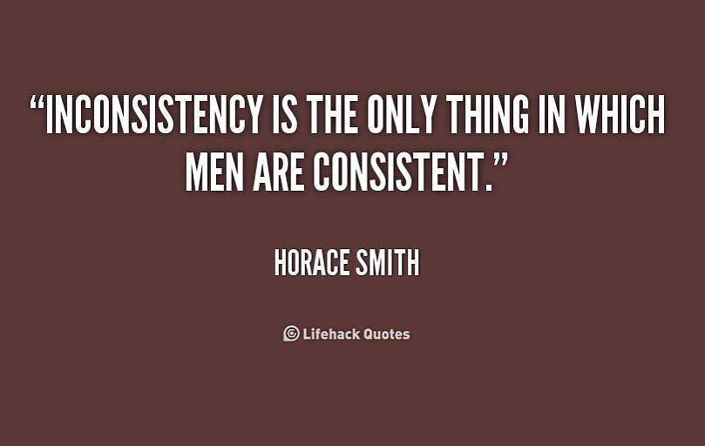
Inconsistencies
The SRS in one case states that the system will be available on all operating systems, and another says that only Windows XP will be used.
The SRS states that the user should be anonymous but the message board should be identified by username.
Why is there a question mark in the “Special Characters” window shown in the User’s Manual when WUSProperties.properties doesn’t show “frCharacters” listing any such question mark?
Notes:
D

Slide 14
Inconsistencies (cont’d)
UPI: SRS | UPI: User’s Manual | UPF
Full Name | First Name | User Name
Location | Last Name | First Name
Title | Job Title | Last Name
Email Address | Phone | Phone
Phone Number | Email | Email
User’s Local Time | Location | Job Title
Online Status | Language | Country
 | Local Time | City
 |  | Language
 |  | Time Zone
User Personal Information (UPI) and User Profile Form (UPF) displays either different categories of information or categories that are out of order, as seen in the table to the right:
Notes:
D

Slide 15

What’s Missing
Glossary
Specific future upgrade plans (if any).
How to turn off dynamic translations
An explanation as to how Altavista’s Babelfish operates.
If the server fails, what is the plan of action?
How do you contact the WUS Administrator?
Alternative translation engines
An “options” menu item.
An explanation as to how multiple files can be uploaded into WUS at one time.
Notes:
D

Slide 16
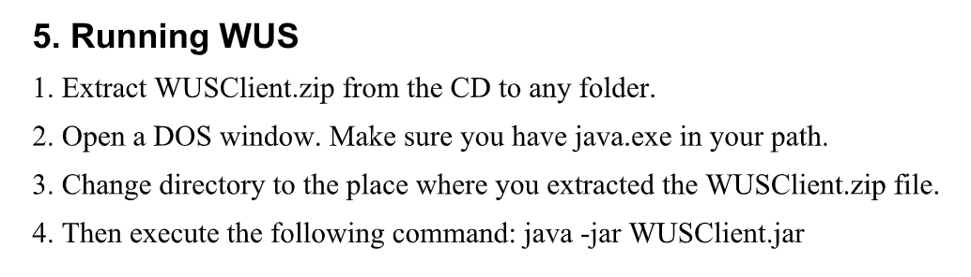
What’s Missing (cont’d)
Directions on how to install and utilize the WUS software, and MySQL on programs like Netbeans, IntelliJ, Eclipse, etc., especially when it comes to:
How to include “java.exe” in one’s “path”.
How to properly incorporate .jar files when utilizing or trying to install the WUS software.
Installing the Java Runtime Engine.
Installing MySQL.
Creating databases and tables.
Executing the WUS software for first time use only.
Actually running the WUS software for more than first time use.
Accessing the WUS database.
How to download the “plugin technology” that establishes a connection between the Internet browser and the Java Platform. What is this “plugin technology” that the Feasibility Study speaks of anyway?
Notes:
D

Slide 17

What’s Missing (cont’d)
How often will implementation take place?
Where is WUS.jar? It doesn’t exist.
An alert that lets the user know if people want to chat with him.
Won’t there have to be people working on WUS who know not just Java and Java Swing, but MySQL as well? Shouldn’t that be a requirement?
Where is the Reference Implementation for the Java Servlet and JavaServer Pages?
What is the application that will have “total control of the graphic display” in WUS?
Where are the Context, Interactive Games, Employee Directory, and Message Board Modules in the User’s and Administrator’s Manuals?
Where are the email and calendar functions?
Notes:
D

Slide 18

What’s Missing (cont’d)
An explanation as to what languages each group member can speak.
How will the Work Breakdown Structure (WBS) be reorganized if someone leaves the project?
Is there a specific format for “Meeting Minutes” reports?
Hardware platforms for WUS
Directions on how to create subfolders in the File Server
Sort and Searching Function in the user list
Why does the README.txt file only say “This is where your source code goes”?
Notes:
D

Slide 19

Easy Fixes
Ability to change regions
Creation of glossaries in the documentation.
Filling in README.txt file on how the software works
Sorting and Searching function for the user list in user directory
Notes:
B

Slide 20
Not as Easy Fixes
Installation of a new translation engine in case Altavista’s Babelfish fails.
Recruiting people familiar with Java Swing and MySQL
Successful recruitment of people who know the languages missing in the WUS software (ex. Arabic, Hebrew, Italian, etc.).
Installation of WUS software into NetBeans, IntelliJ, Eclipse, etc. to ensure that it can be worked on using different programs other than the command prompt.
Integration of future modules/components into the WUS software.
Notes:
D

Slide 21
Not as Easy Fixes (cont’d)
Installation of the following functions:
An email function.
A calendar function.
Message board implementation
A function allowing the user to turn off dynamic translation at any time.
Notes:
D

Slide 22

Suggested Improvements to WUS Software
Enhance usability for people with disabilities
Help function with software features
Confirmation dialogs
Help determine port number and server IP
Notes:
B

Slide 23


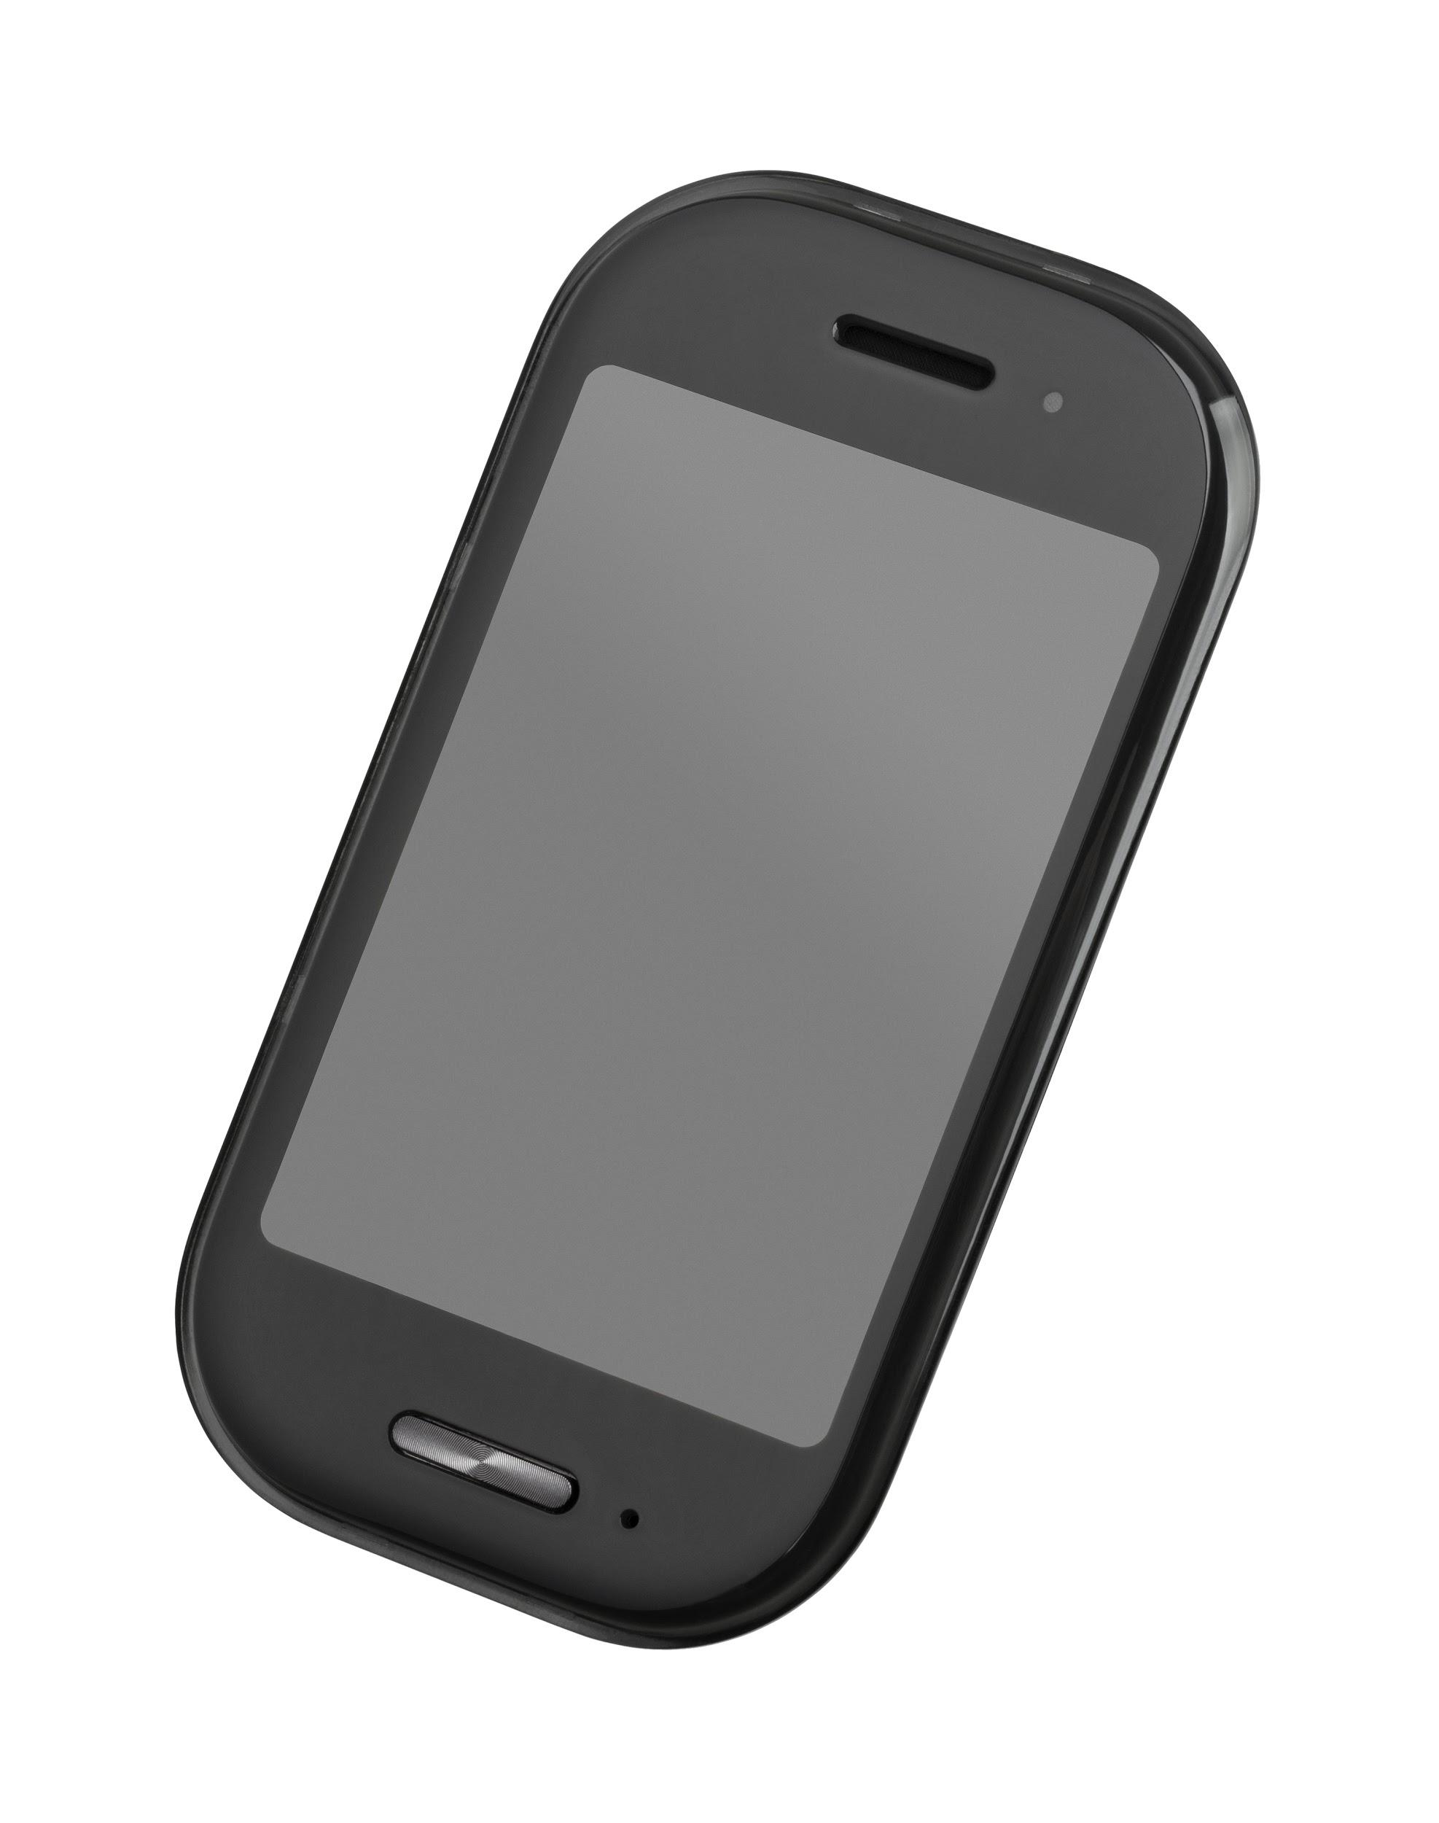
Suggested Improvements to WUS Software (cont’d)
Adding functions like the following:
Notifications (chat, update, etc…)
A Recycle Bin function
Allowing the user to choose which file format that copied files appear on their file tables.
Allowing the user to, when renaming a file, alter its file extension.
Addition of emoticons.
Providing the user the option to toggle between various languages in the Special Characters window of the Chat Module.
Mobile Application
Notes:
B

Slide 24

Suggested Improvements to WUS Software (cont’d)
Forgot password feature
More language options
An email function.
A calendar function.
More supported document uploads
Tutorials
Addition of FAQ sections.
Ability to hide some personal information if desired
Notes:
Ari

Slide 25

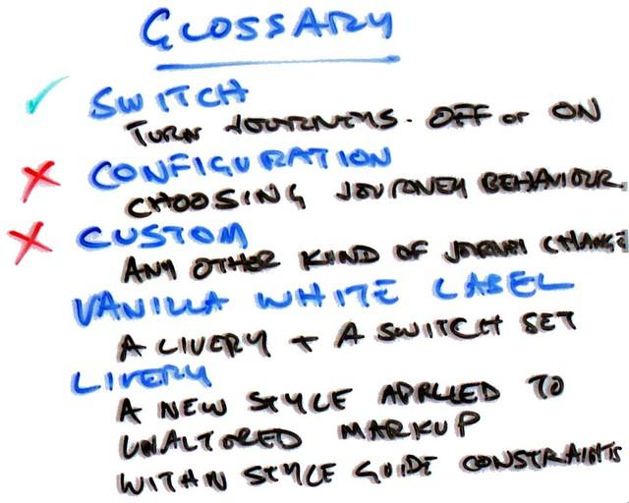
Suggested Improvements to WUS Documentation
Problems are seen in the Table of Contents section of the following documents:
Administrator’s Manual: Some of the titles of each section listed aren’t the same as those stated on the pages they start on. For example, “Installing Java Runtime Engine” is listed on the Table of Contents section as “Installing Java”.
SRS: Each section and subsection of the document are stated to begin on pg. 4, which is inaccurate.
Test Plan: There are inaccuracies as to which sections are stated to start on which pages (ex. “Test Case 2” actually starts on pg. 5, not pg. 4 as stated in the Table of Contents section.).
Glossaries
Notes:
Ari

Slide 26

Conclusion
The WUS Software can be a useful tool to help bridge the language gap
If done properly, this software can make a big difference
However, many changes still have to be made in order to make this a useful product
Notes:
D

Slide 27

Questions?

Slide 28
Whatever You Say (WUS) - Documents
The WUS project consists of multiple documents, including:
Software Requirements Specification (SRS).
Test Plan.
Feasibility Study.
User’s Manual.
Administrator’s Manual.
Software Design Specification (SDS).
Source code.

Slide 29
State of Communications Today
“If you talk to a man in a language he understands, that goes to his head. If you talk to him in his language, that goes to his heart.”
-Nelson Mandela
As the world became more interconnected with the following results:
Marketplaces span continents.
Meetings take place hemispheres apart.
Companies are becoming close to far-flung markets by consisting of people of different nationalities.
What this did was create the necessity to know the languages of many of the people being employed by transnational companies (TNCs) to reduce misunderstandings, as well as to understand the cultures of foreign employers.
Understanding other languages would not only make foreigners be seen as human beings rather than simply foreign labor.

Slide 30
Global Communication Barriers
People not feeling comfortable speaking in a co-worker’s native language due to:
Lack of proficiency in another language.
A sense of national pride and self-worth from speaking one’s own language instead of another one.
Misunderstandings caused by an inability to speak another language, which lead to errors, as well as workers becoming less efficient by spending time making themselves understood.
Foreign workers feeling enslaved to their employer’s culture, which is caused by:
Struggling to speak a language one does not understand.
The company disregarding foreign workers’ national holidays, among other things.

Slide 31
Whatever You Say (WUS) - Modules
The WUS software consists of the following modules:
Login Module: allows authorized users to login to the WUS.
User Directory: provides basic information on various people whom the user wishes to talk to.
Employee Directory: identifies each employee’s country.
File Server: allows users to view files in their native language and serves as a public space to share and copy other users’ files.
Chat Module: allows the user to communicate with other users using his own language. Internet/Intranet Module: allows users to view web based documents either in an original or the user’s language.
Context Module: supplies information about local news, along with a coworker’s current time, weather, and calendar.
Interactive Games Module: supplies interactive games in which each user sees the game board in their native language.
Administrator Module: allows the administrator to control all functionalities/modules and users in the WUS software.

Slide 32
Whatever You Say (WUS) - Modules
Other modules in the WUS software include:
Context Module: supplies information about local news, along with a coworker’s current time, weather, and calendar.
Interactive Games Module: supplies interactive games in which each user sees the game board in their native language.
Administrator Module: allows the administrator to control all functionalities/modules and users in the WUS software.
Message Board Module: allows users to discuss various topics.

